Slide 1
Turbulent Natural Convection in a Square Cavity
ERCOFTAC SIG15 Workshop
16th of October 2019
Cédric Flageul

Slide 2
Ra = 1.10⁸ | Ra=1,58.10⁹
Dimokratis Grigoriadis, Univ. Cyprus, LES CS => Smagorinsky FSF => Filtered Structure Function
 | Constantinos Katsamis, Manchester, RANS k-epsilon k-omega-SST BL-v²/k LRR SSG EBRSM

Slide 3
Ra = 1.10¹⁰ | Ra=1.10¹¹
Dimokratis Grigoriadis, Univ. Cyprus, LES CS => Smagorinsky FSF => Filtered Structure Function
Jean-François Wald, EDF R&D DDES BL-v2/k EBRSM - (EB)AFM EBRSM - (EB)DFM EBRSM - (EB)GGDH | Abdelmagid Emad Ali, Manchester Hybrid RANS / LES (dual mesh)
 | Constantinos Katsamis, Manchester RANS (see previous slide)
 | Puneeth Reddy, Pau RANS Modifications of k-omega SST
 | Dean Wilson, Manchester Launder-Sharma + SG Jakirlić and Hanjalić + GG

Slide 4
Square cavity at Ra=1.10⁸ :
Turbulent kinetic energy
Velocity
Wall-normal turbulent heat flux
Streamwise turbulent heat flux
Temperature
Temperature variance
Nusselt numbers

Slide 5
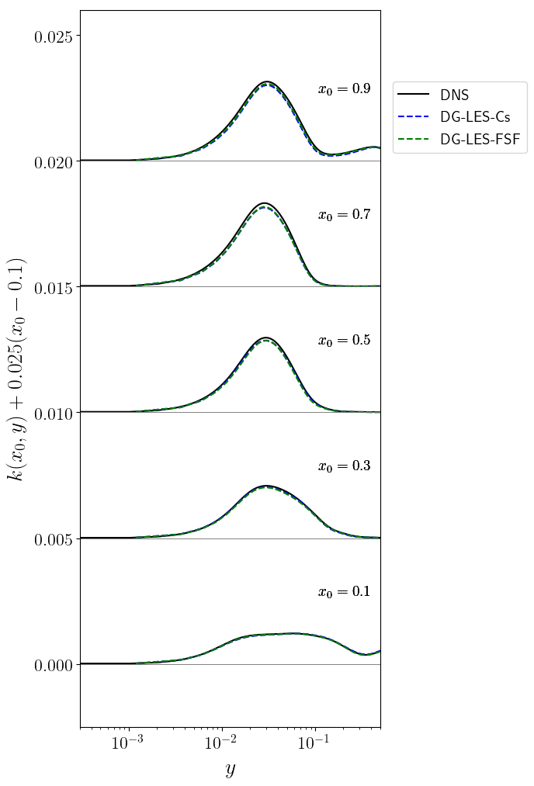
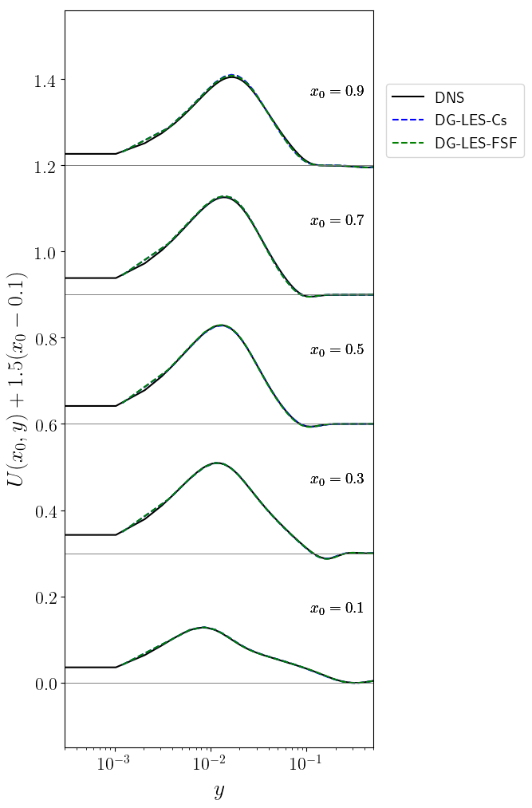

Slide 6
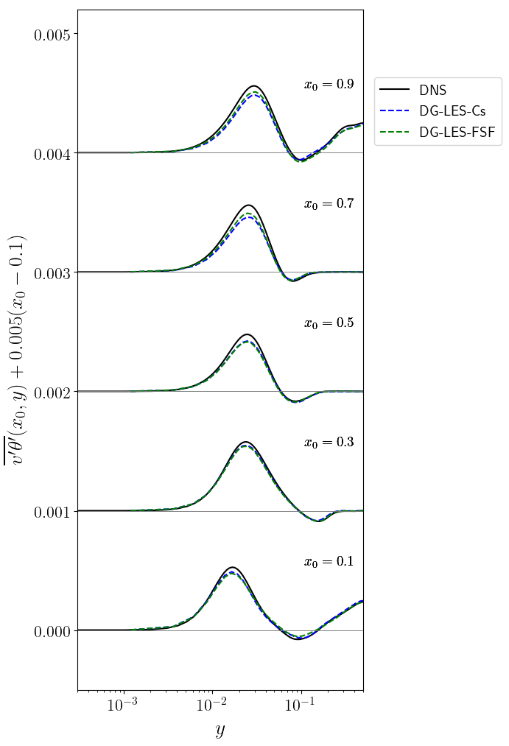
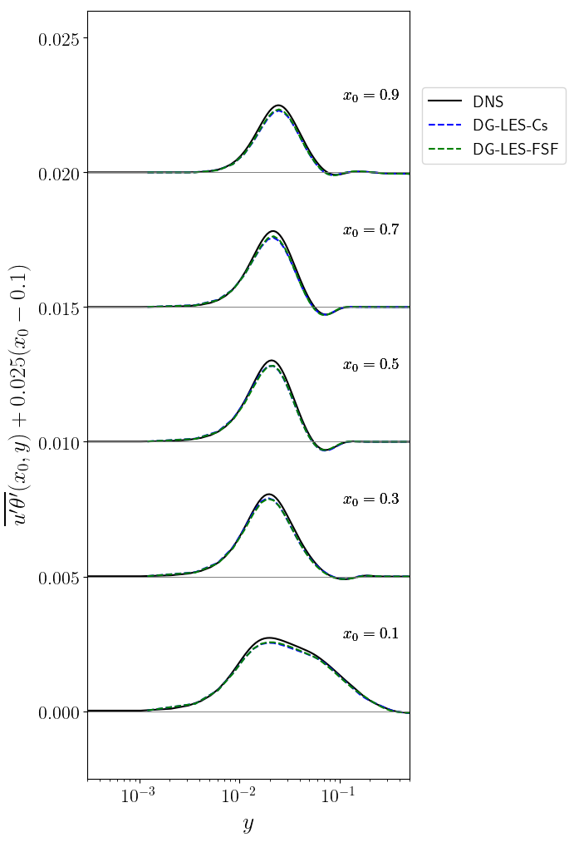

Slide 7
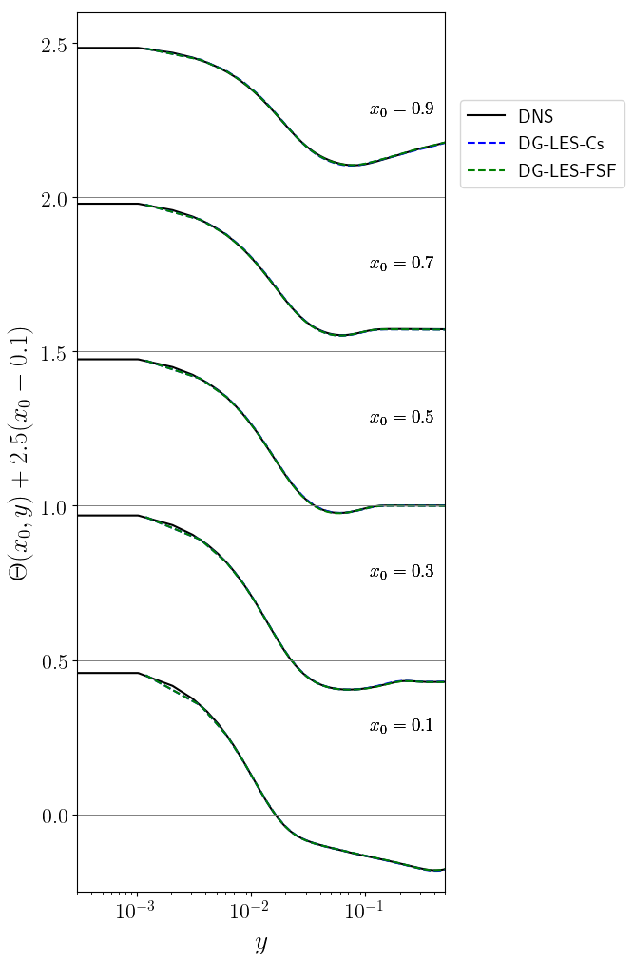
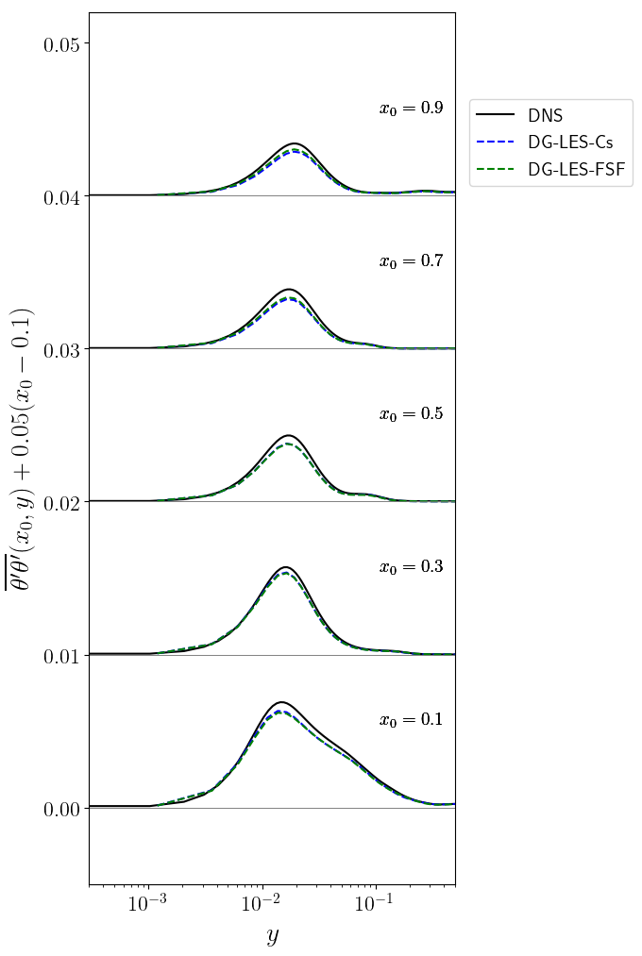

Slide 8
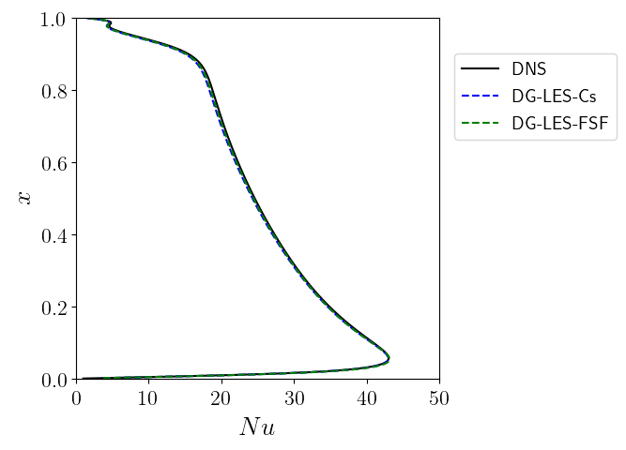

Slide 9
Square cavity at Ra=1,58.10⁹ :
Turbulent kinetic energy
Velocity
Wall-normal turbulent heat flux
Streamwise turbulent heat flux
Temperature
Temperature variance
Nusselt numbers

Slide 10
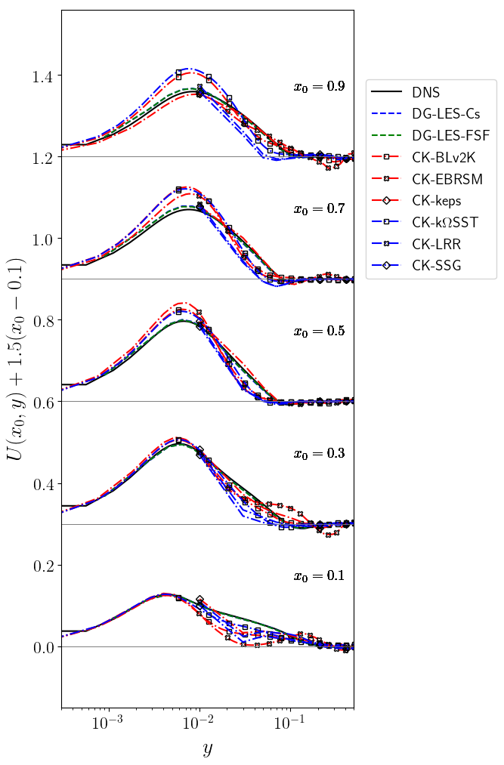
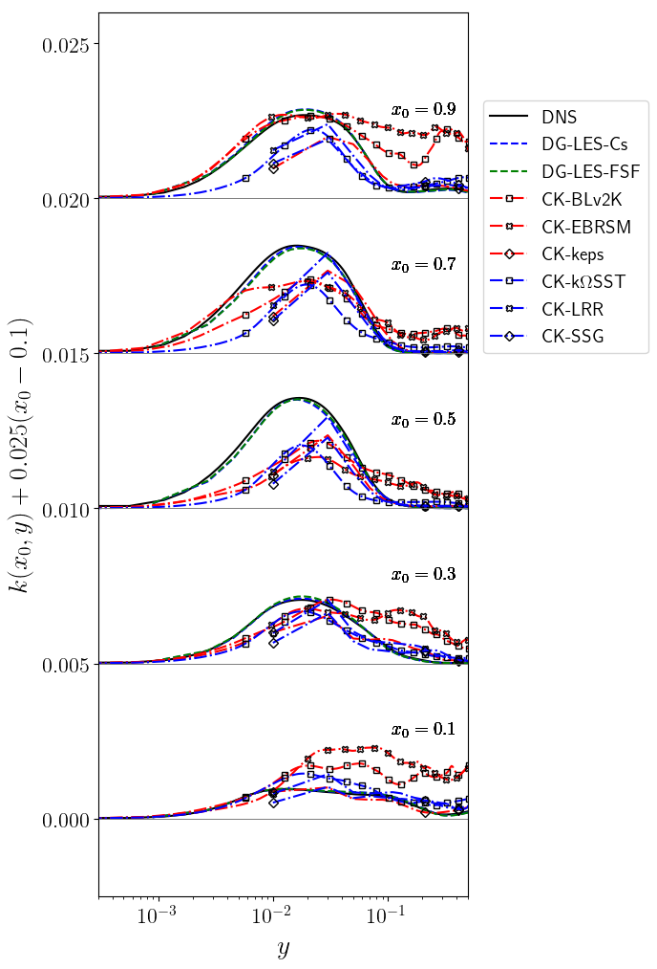

Slide 11
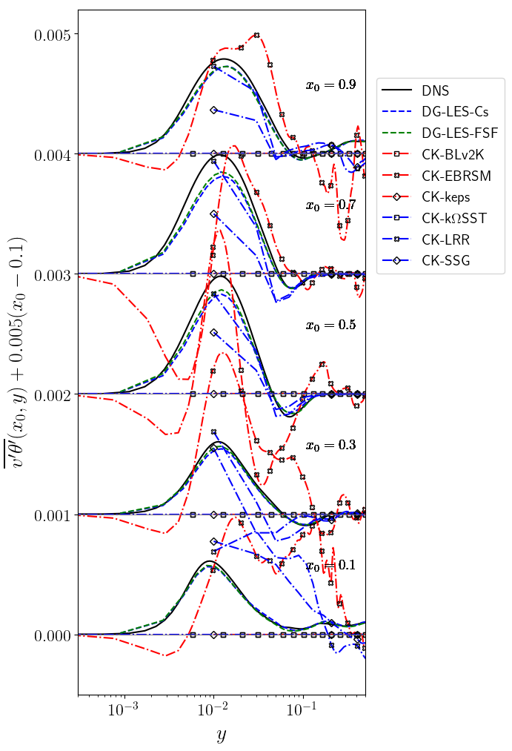
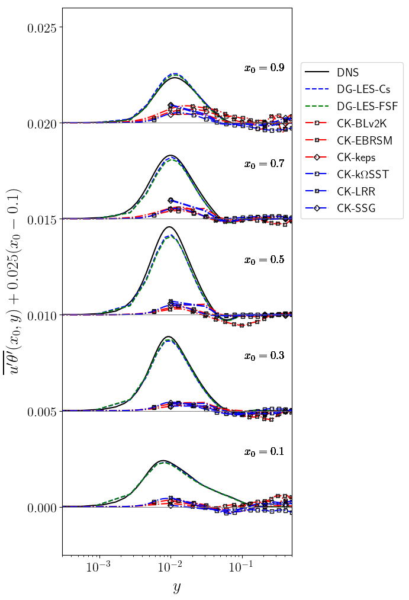

Slide 12
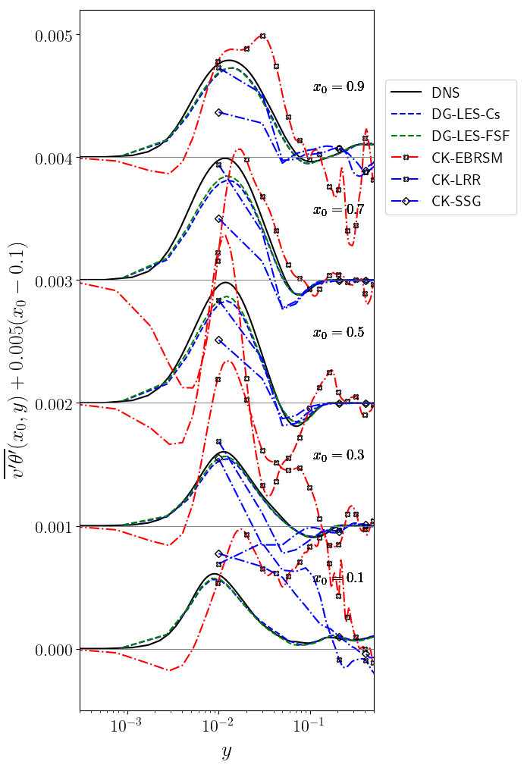

Slide 13
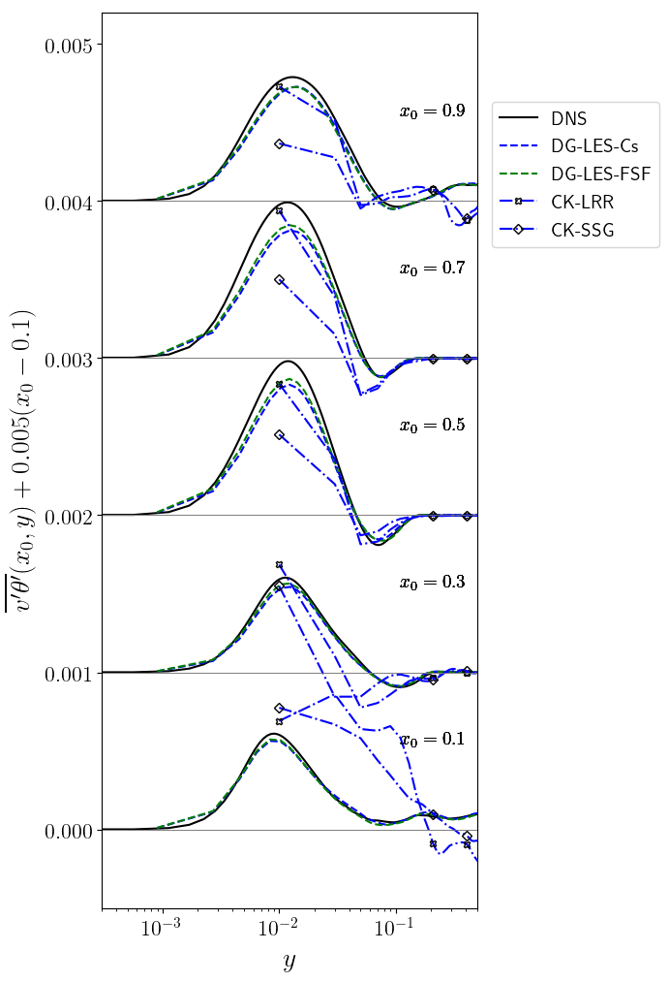

Slide 14
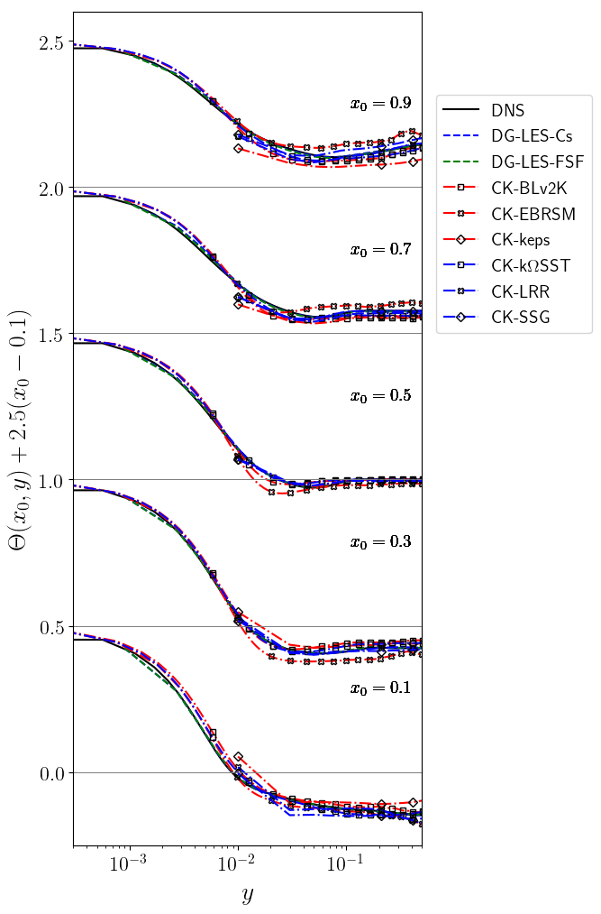
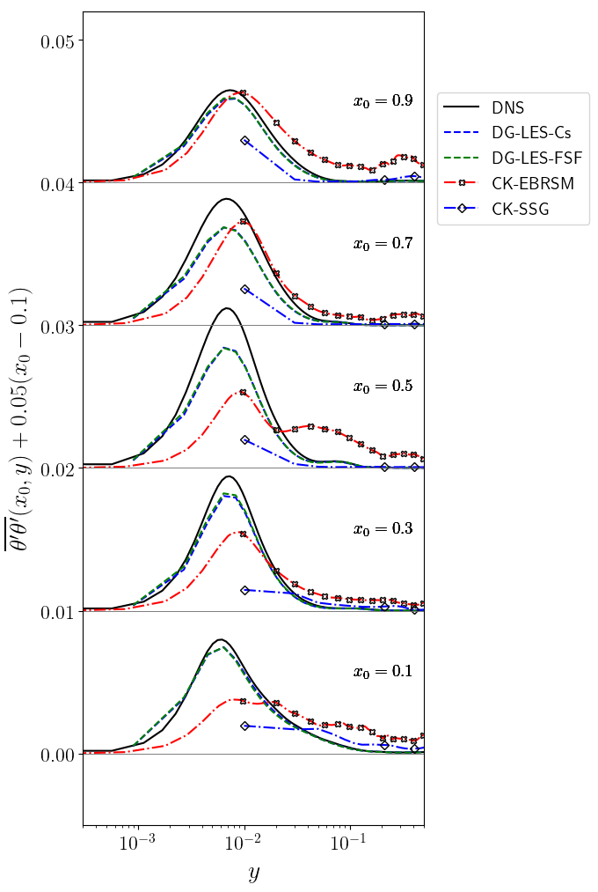

Slide 15
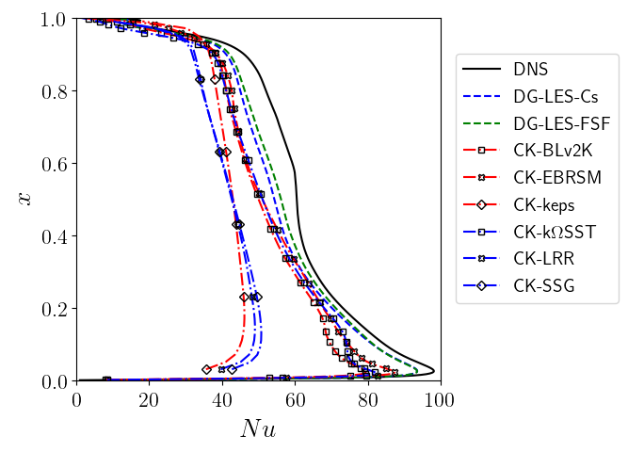

Slide 16
Square cavity at Ra=1.10¹⁰ : LES and hybrid RANS-LES cases
Turbulent kinetic energy
Velocity
Wall-normal turbulent heat flux
Streamwise turbulent heat flux
Temperature
Temperature variance
Nusselt numbers

Slide 17
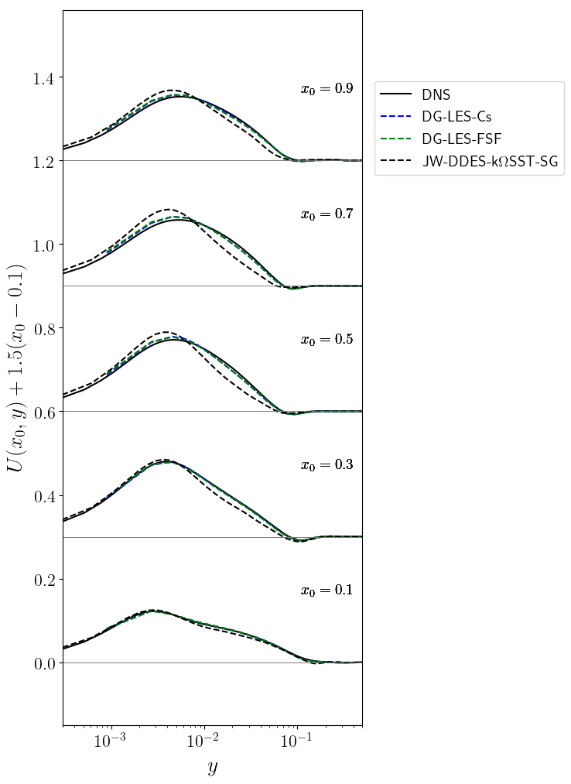
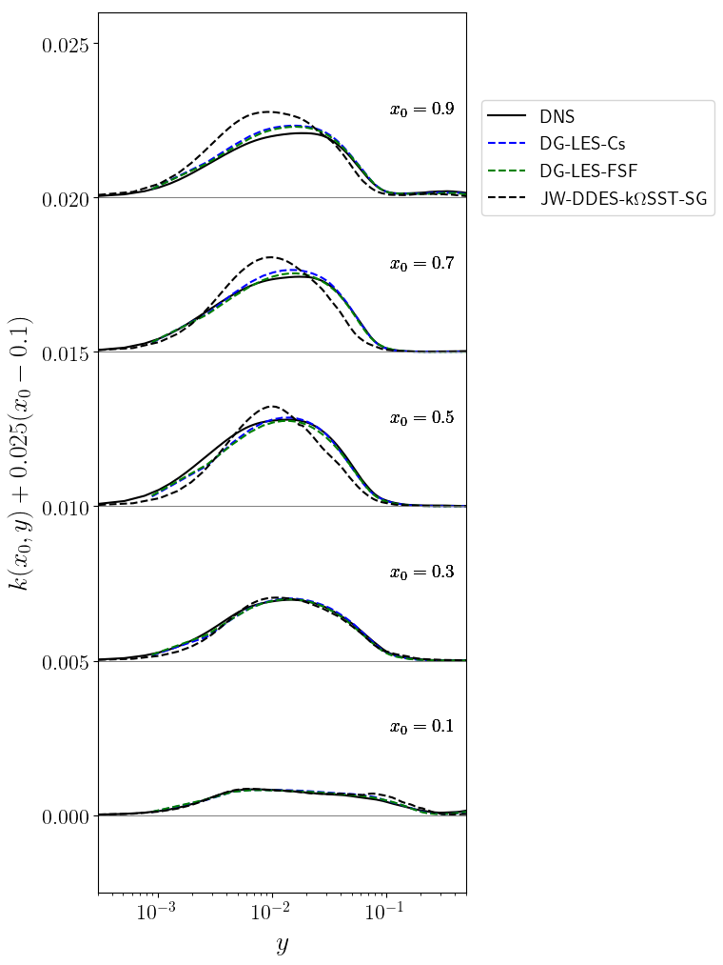

Slide 18
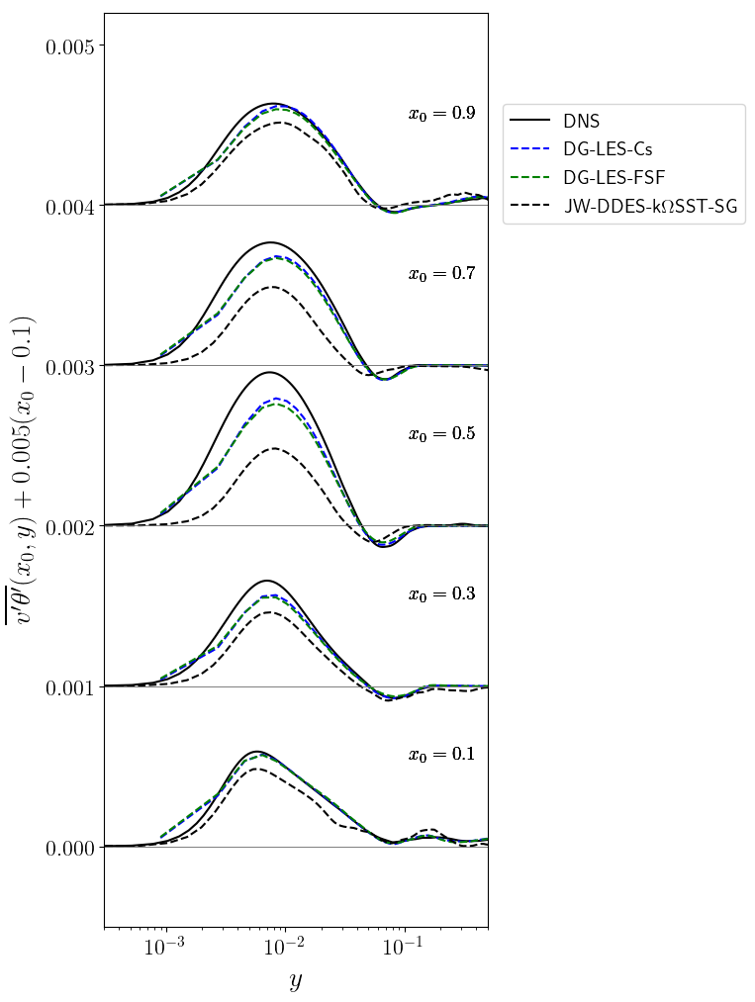
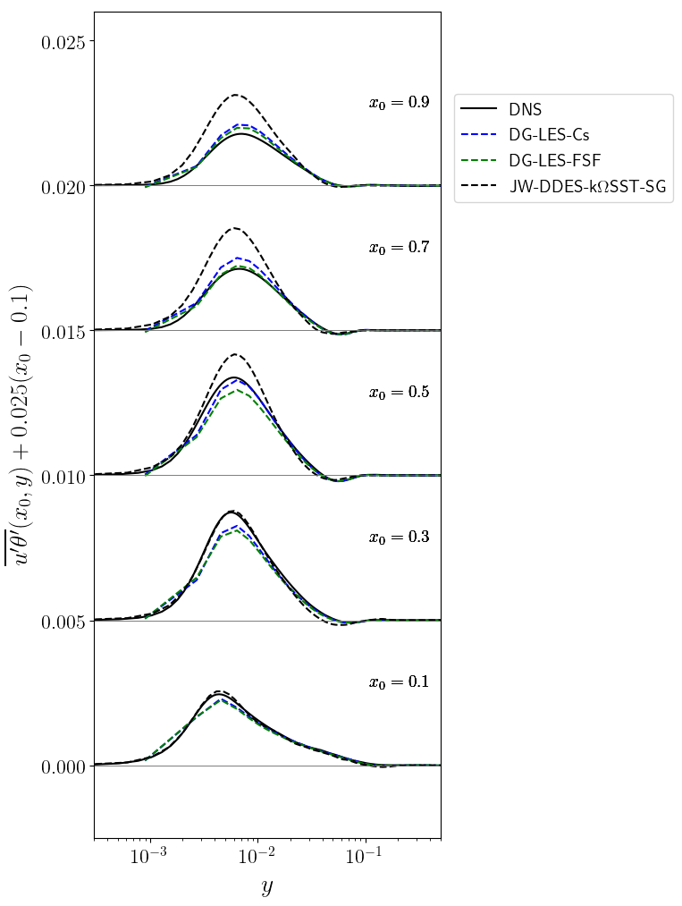

Slide 19
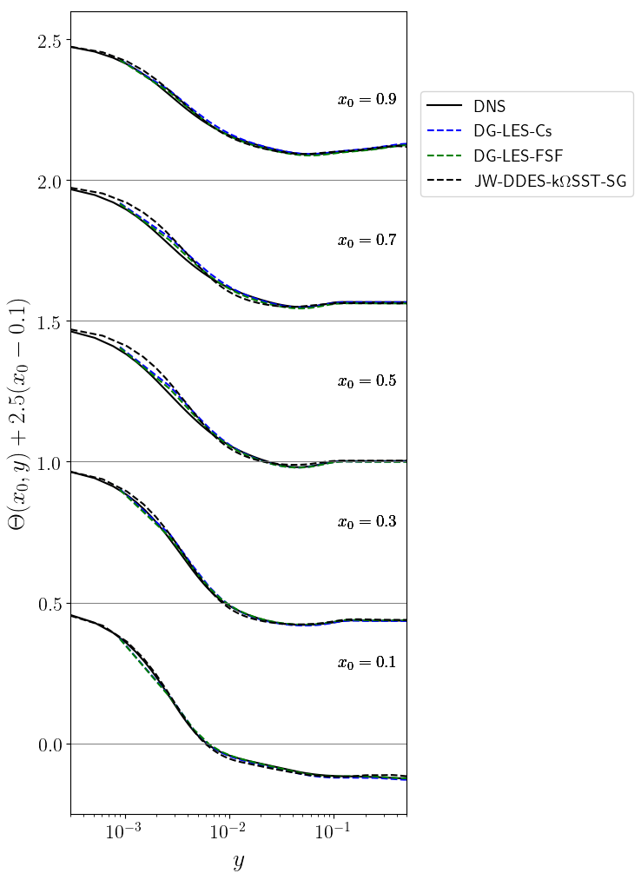
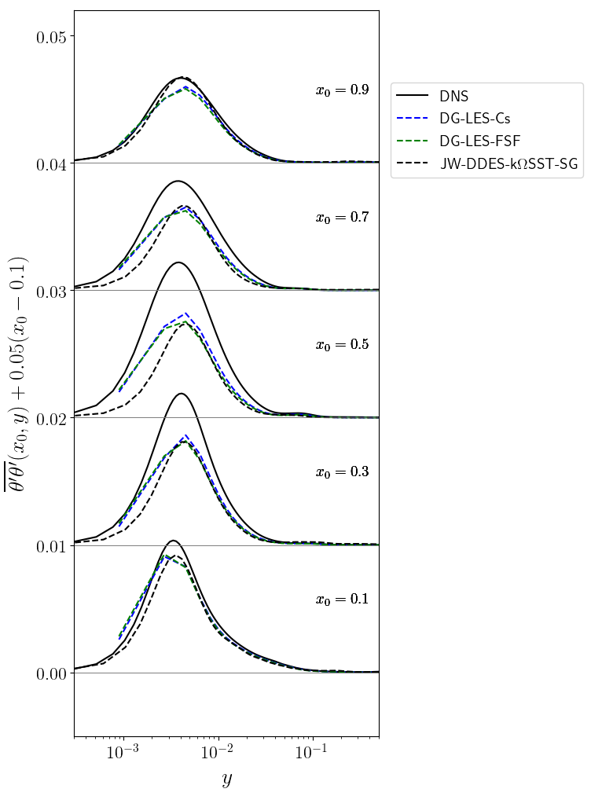

Slide 20
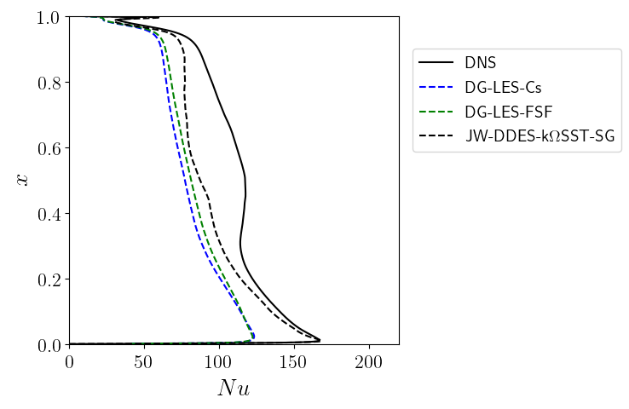

Slide 21
Square cavity at Ra=1.10¹⁰ : RANS cases
Turbulent kinetic energy
Velocity
Wall-normal turbulent heat flux
Streamwise turbulent heat flux
Temperature
Temperature variance
Nusselt numbers

Slide 22
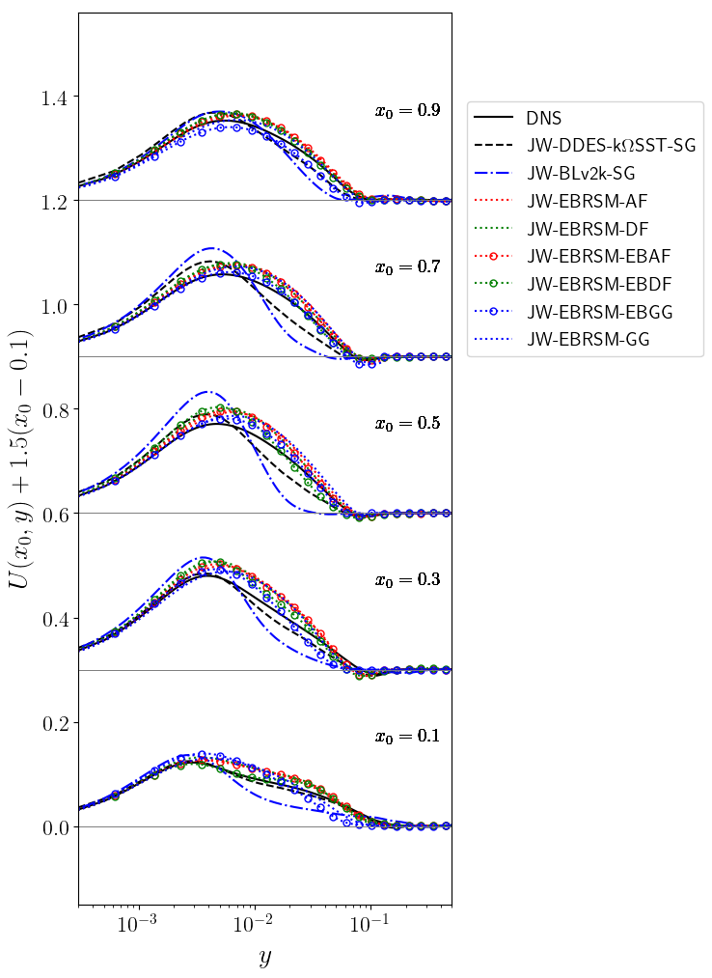
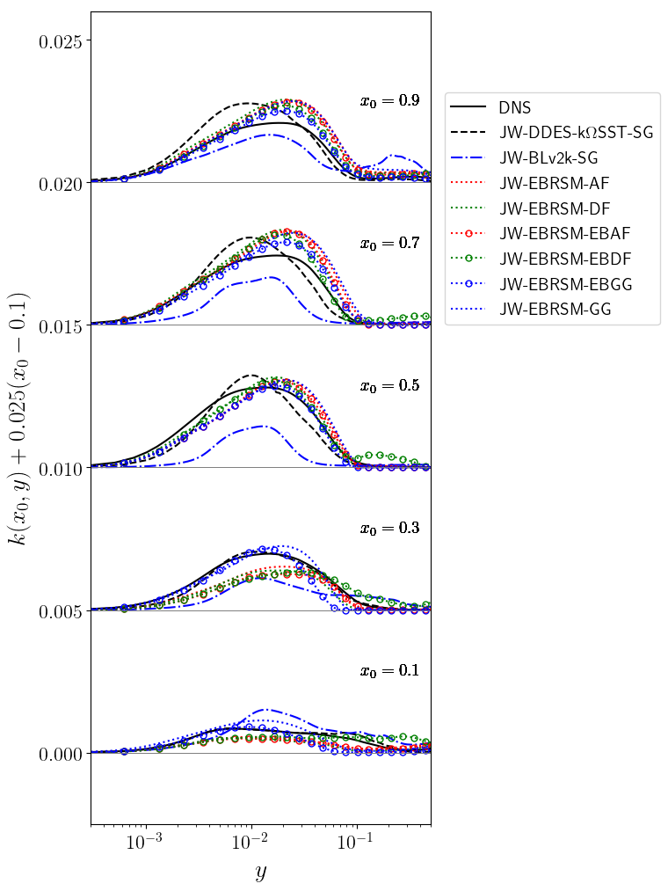

Slide 23
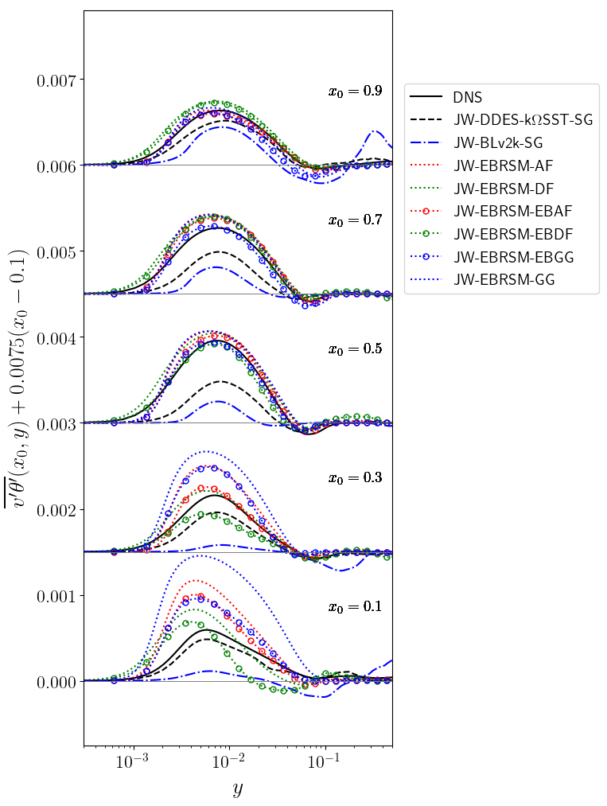
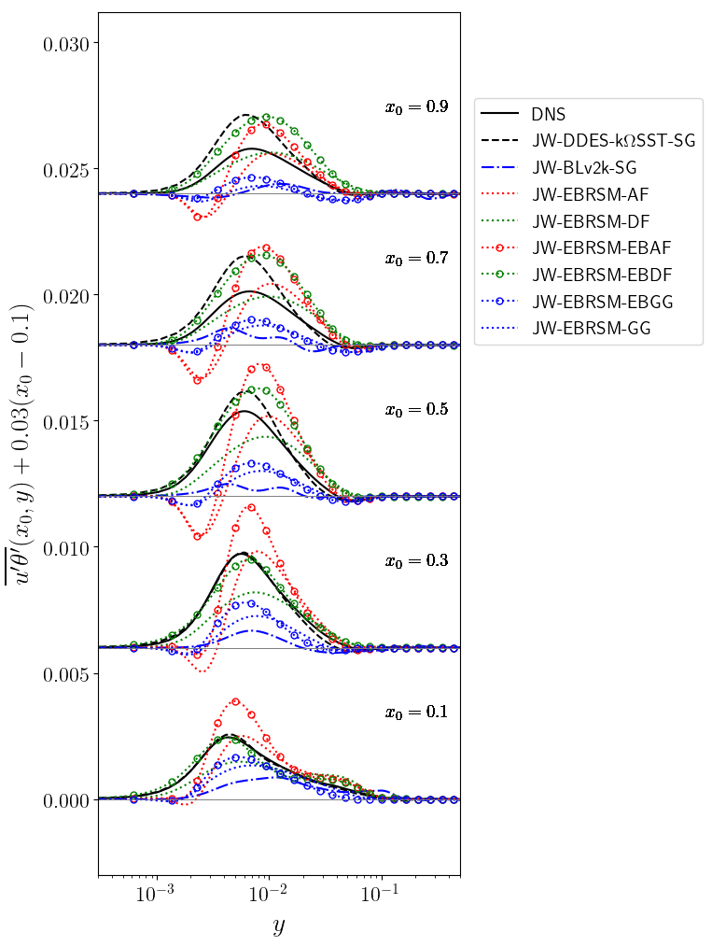

Slide 24
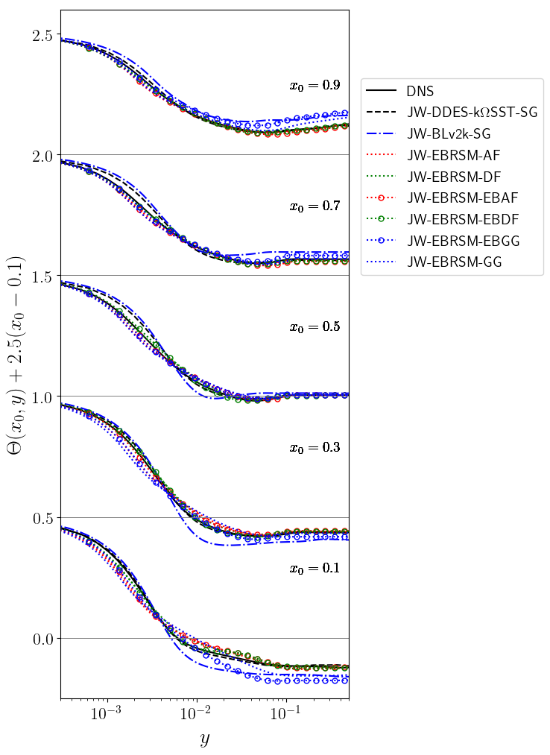
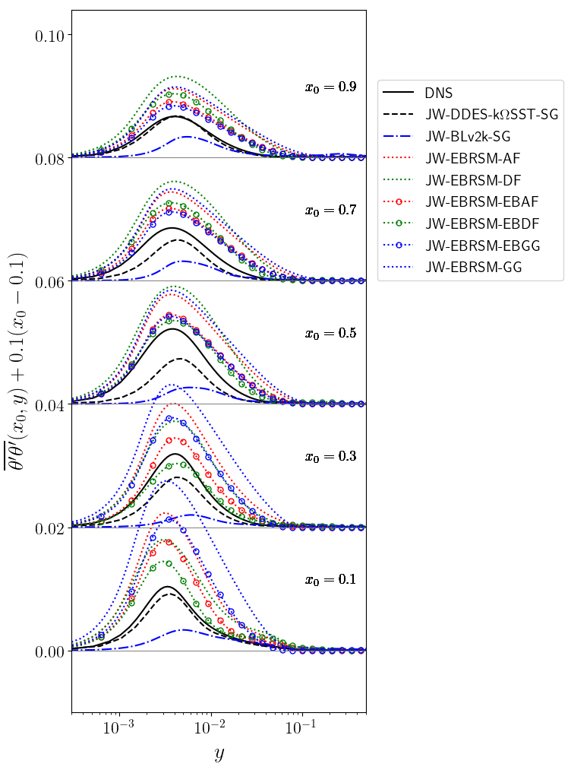

Slide 25
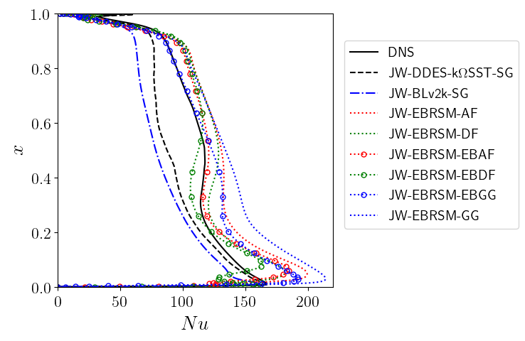

Slide 26
Square cavity at Ra=1.10¹¹ : RANS cases
Turbulent kinetic energy
Velocity
Wall-normal turbulent heat flux
Streamwise turbulent heat flux
Temperature
Temperature variance
Nusselt numbers

Slide 27
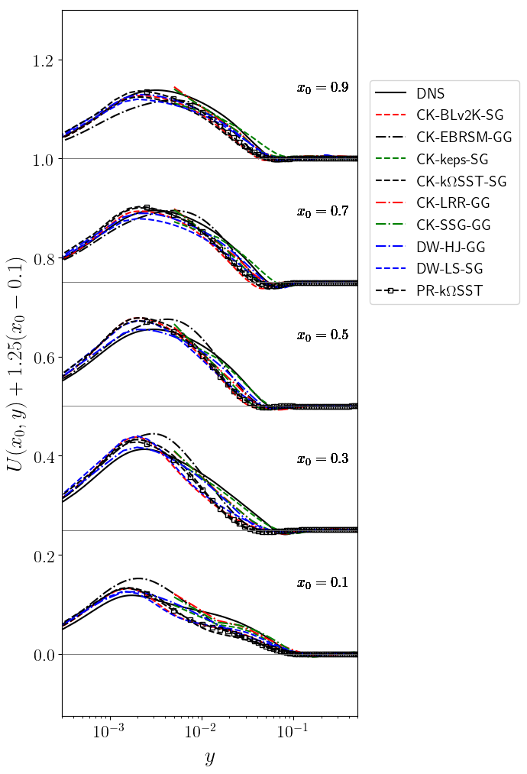
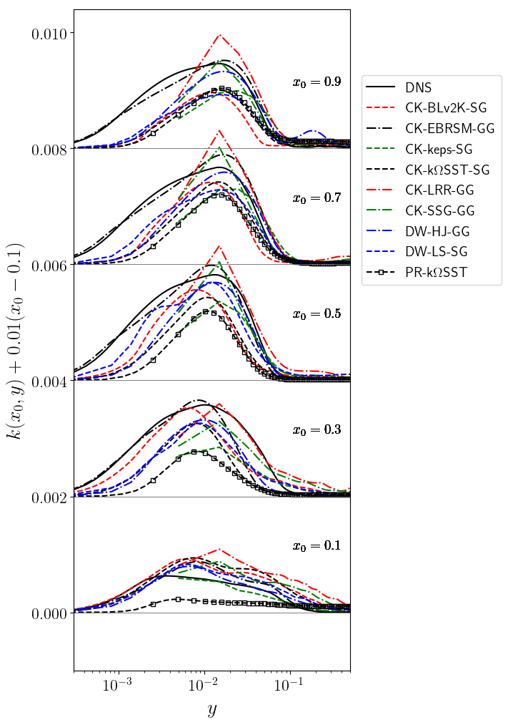

Slide 28
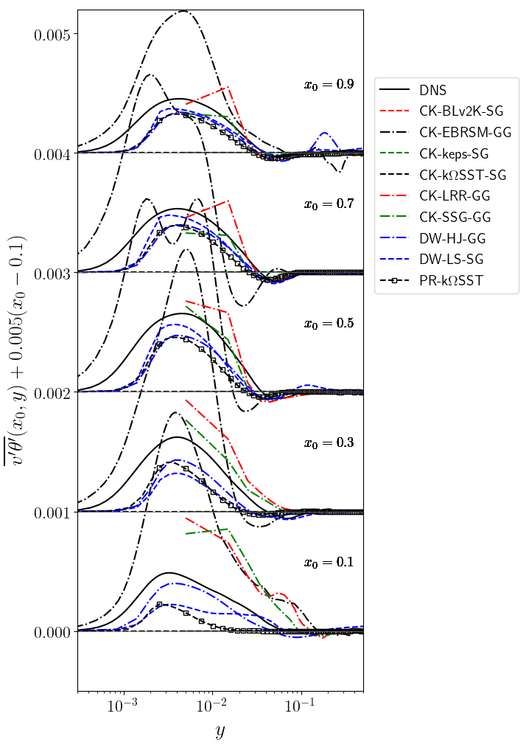
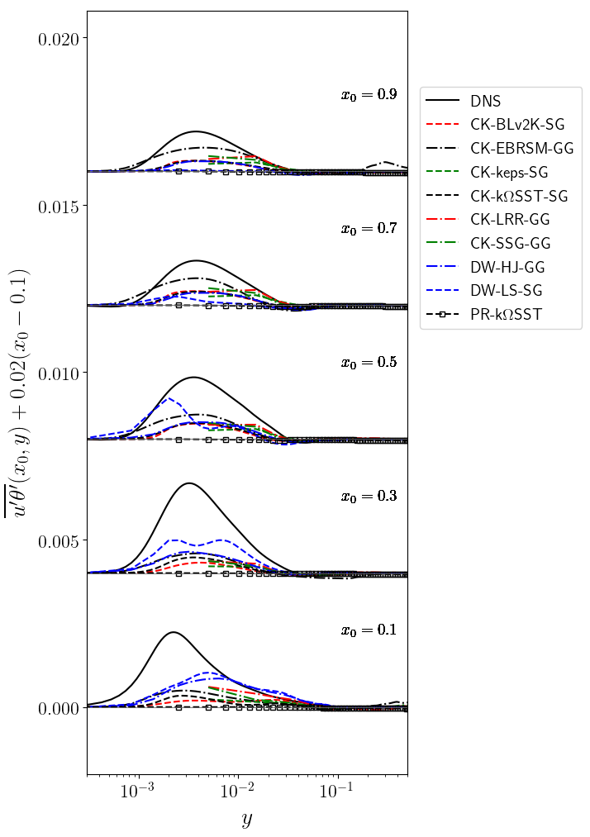

Slide 29
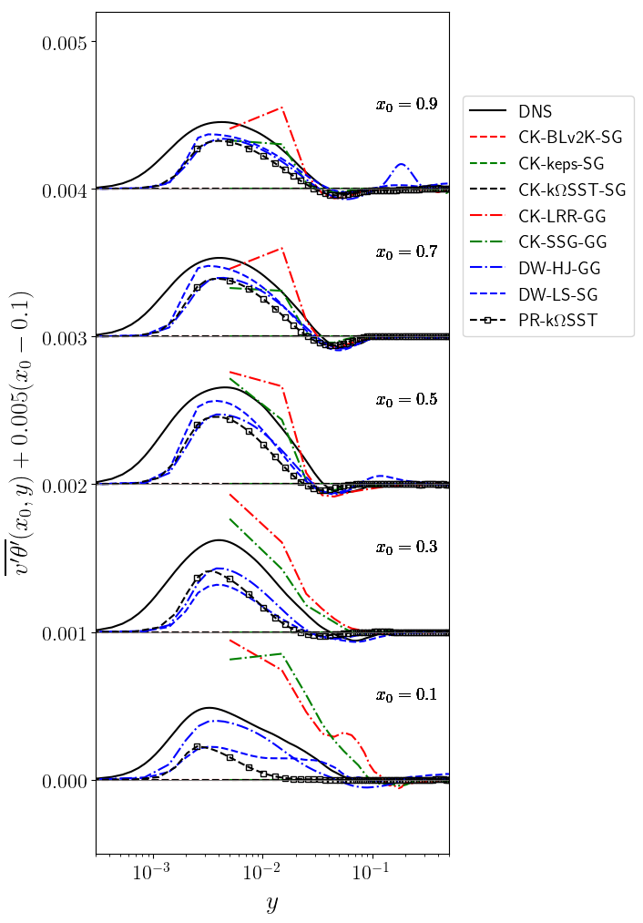

Slide 30
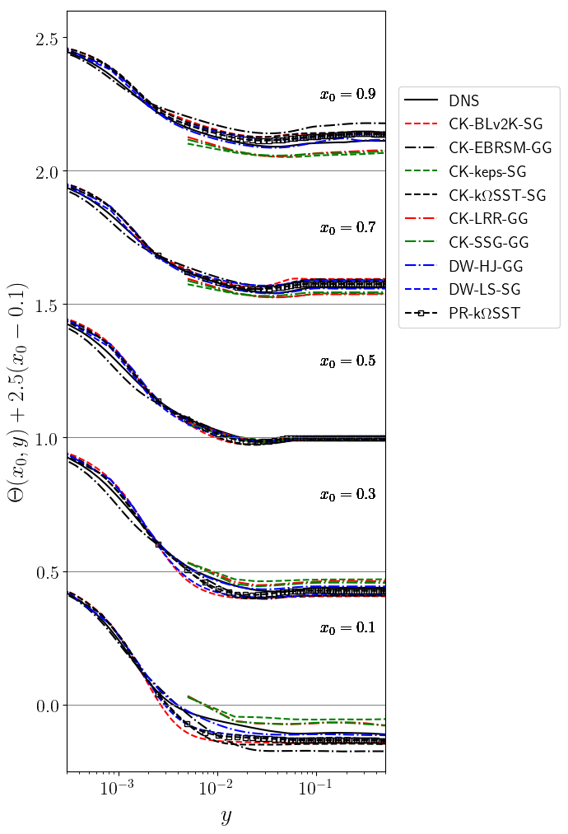
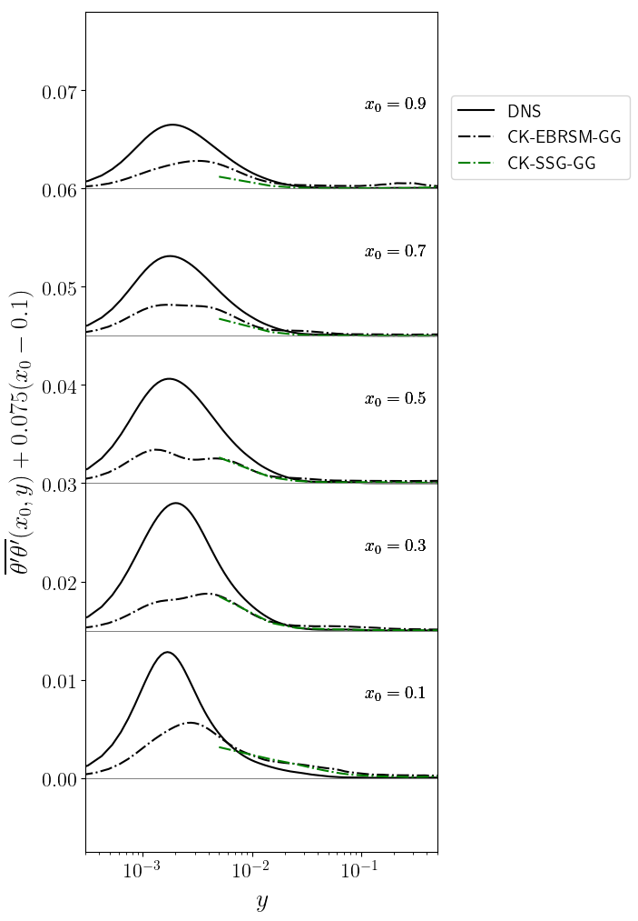

Slide 31
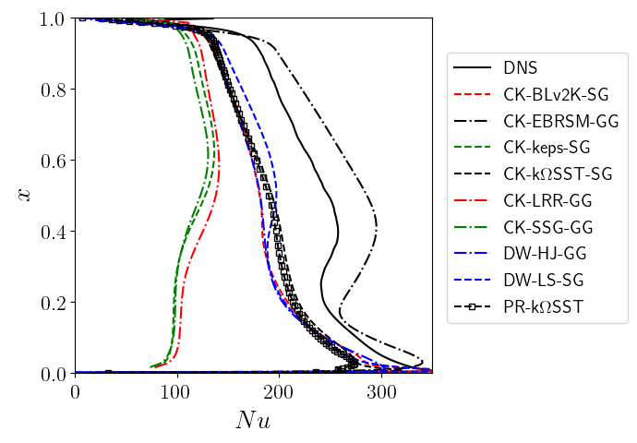

Slide 32
Square cavity at Ra=1.10¹¹ : k-omega cases
Turbulent kinetic energy
Velocity
Wall-normal turbulent heat flux
Streamwise turbulent heat flux
Temperature
Temperature variance
Nusselt numbers

Slide 33
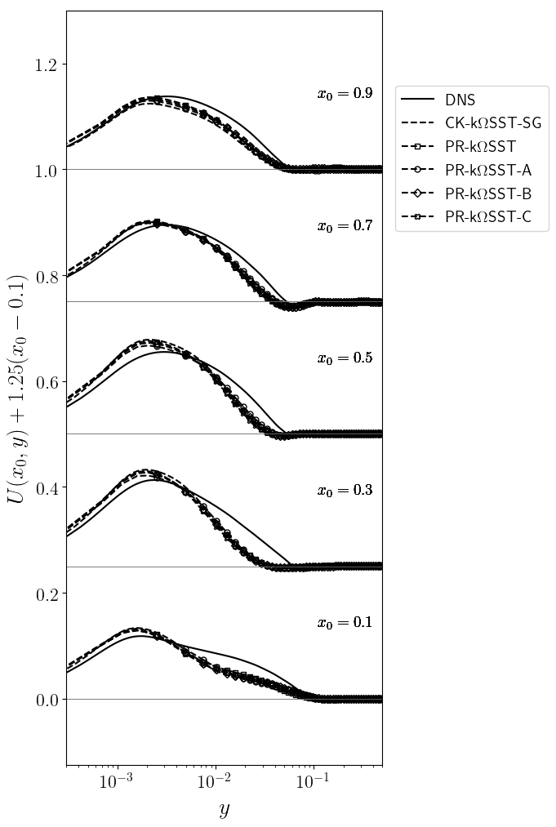
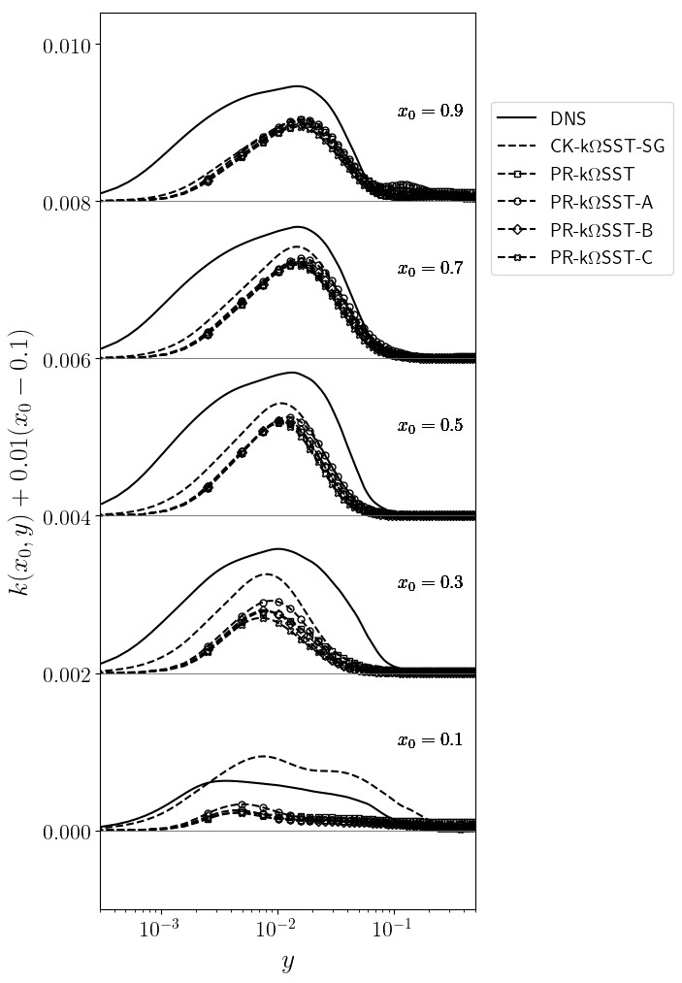

Slide 34
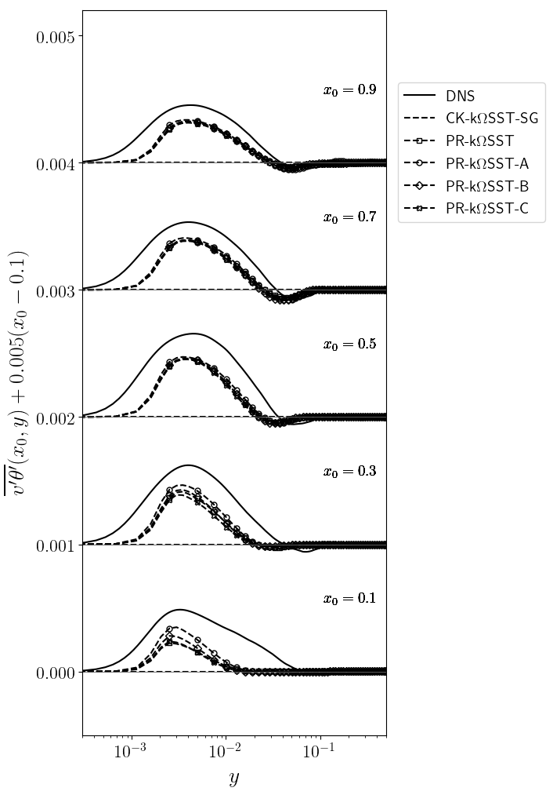
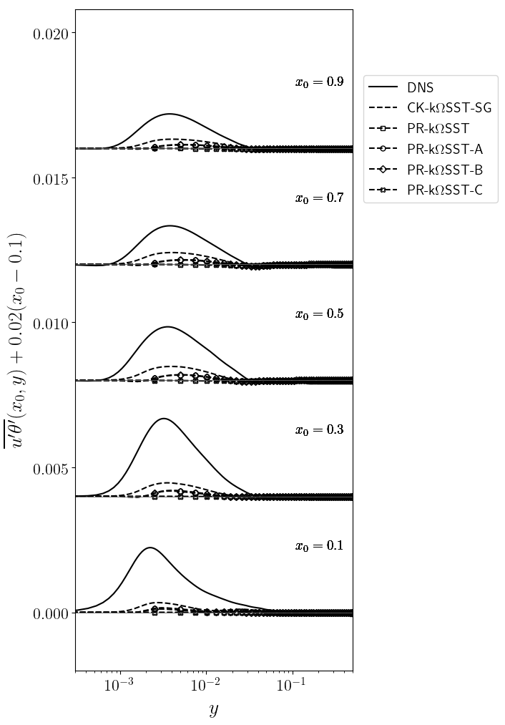

Slide 35
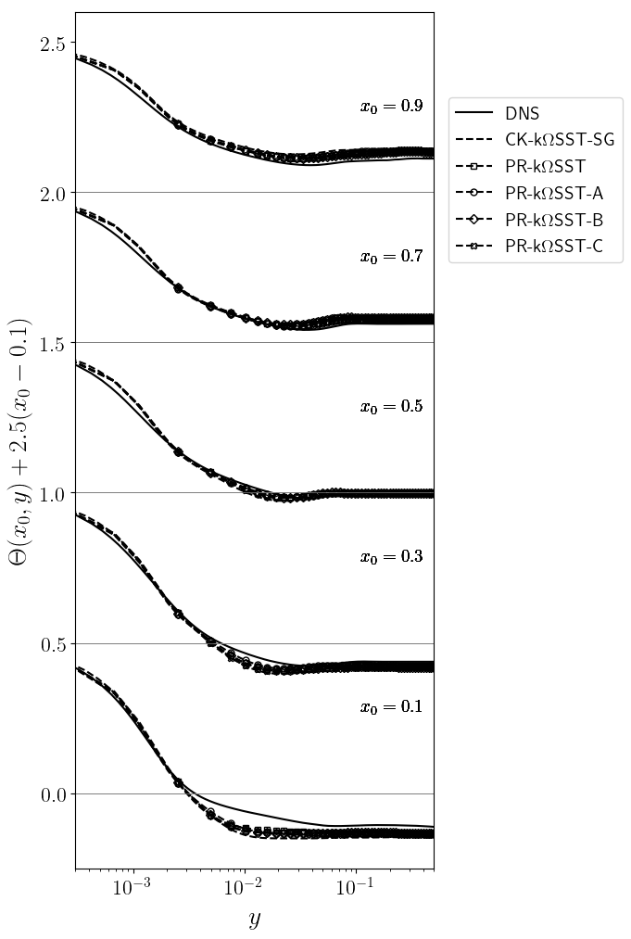

Slide 36
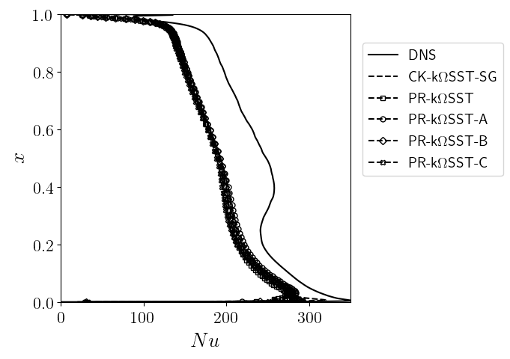

Slide 37
Square cavity at Ra=1.10¹¹ : LES and hybrid RANS-LES cases
Turbulent kinetic energy
Velocity
Wall-normal turbulent heat flux
Streamwise turbulent heat flux
Temperature
Temperature variance
Nusselt numbers

Slide 38
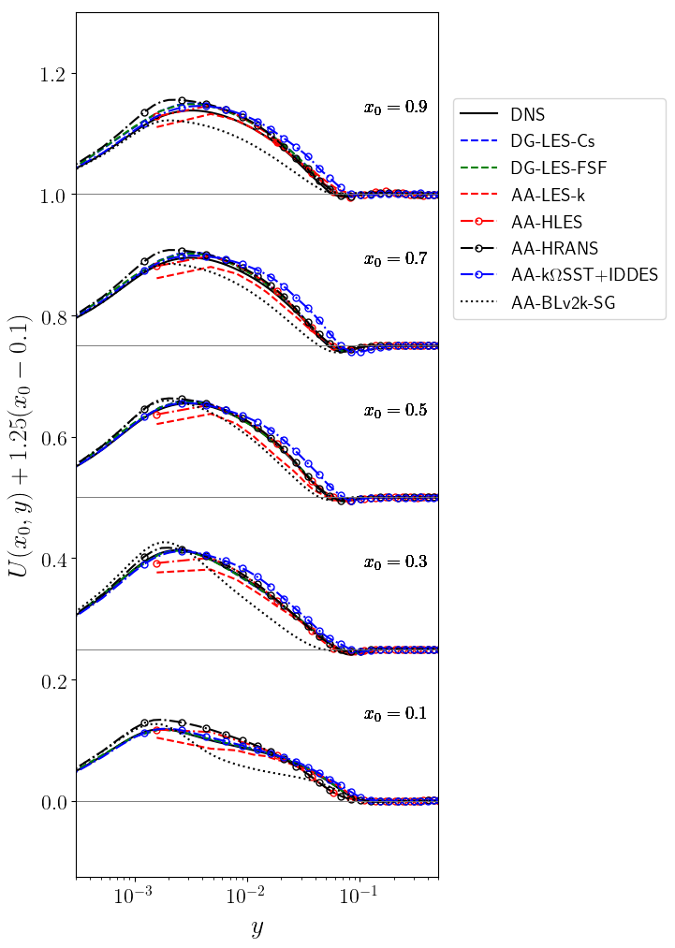
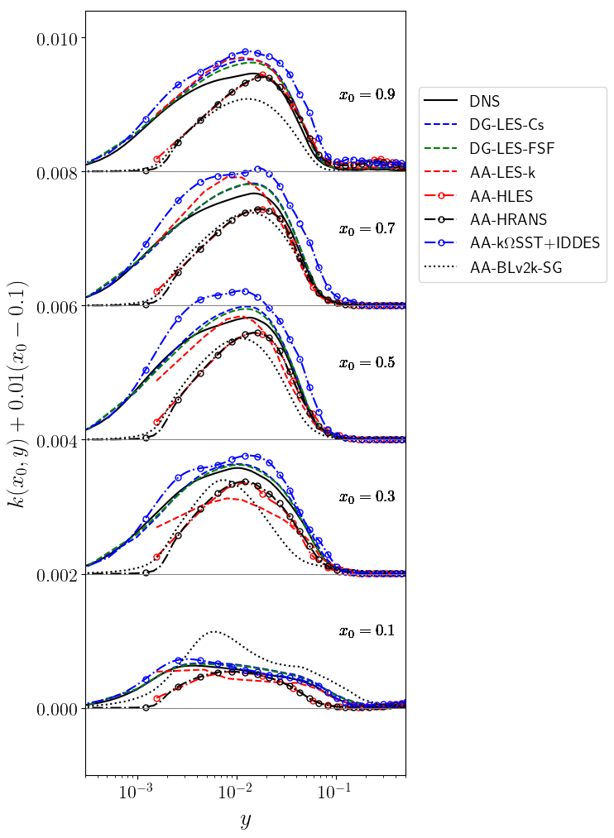

Slide 39
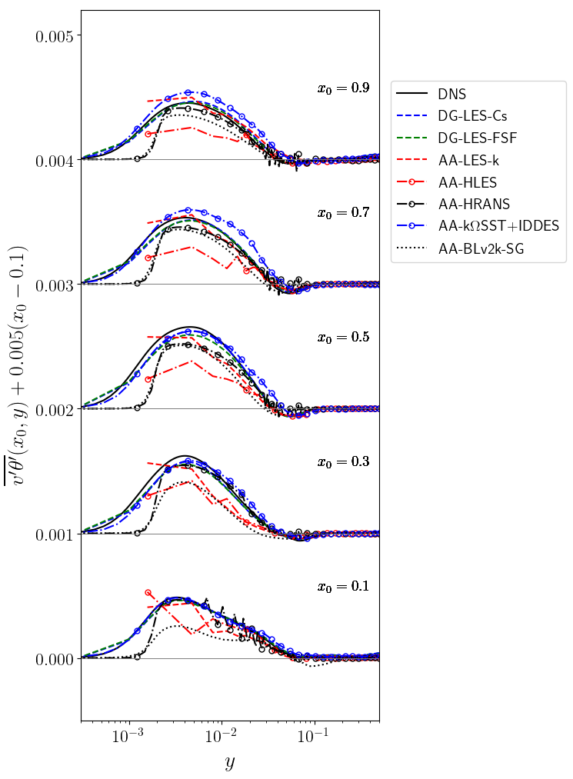
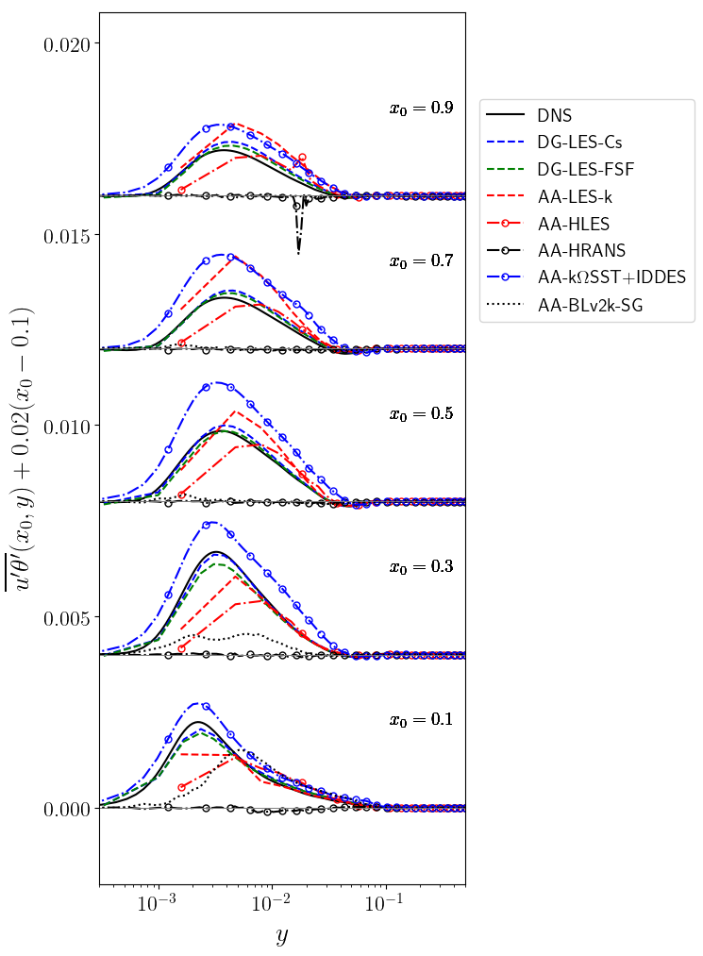

Slide 40
